Slide 1

Project Alpha

Slide 2
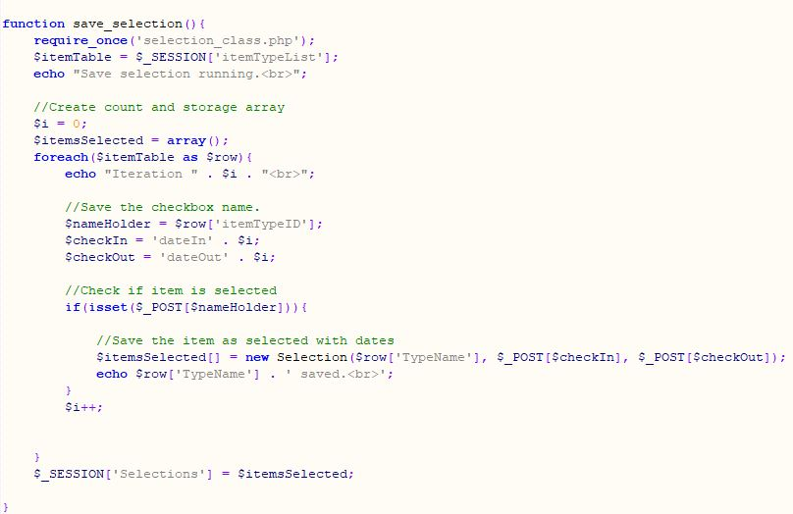
Saving User Selections (PHP)

Slide 3
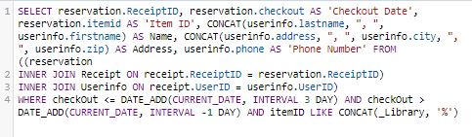
Building the Outgoing Info (MySQL)

